Slide 1
Azure Static Web Apps
A modern web app service that offers streamlined full-stack development from source code to global high availability.

Slide 2

Andreas Wänqvist
Voyado – Cloud Architect
Aurelia – Core Team (2017->)
ex MSFT – Azure
@mobilemancer
www.linkedin.com/in/awanqvist/
mobilemancer.com

Slide 3
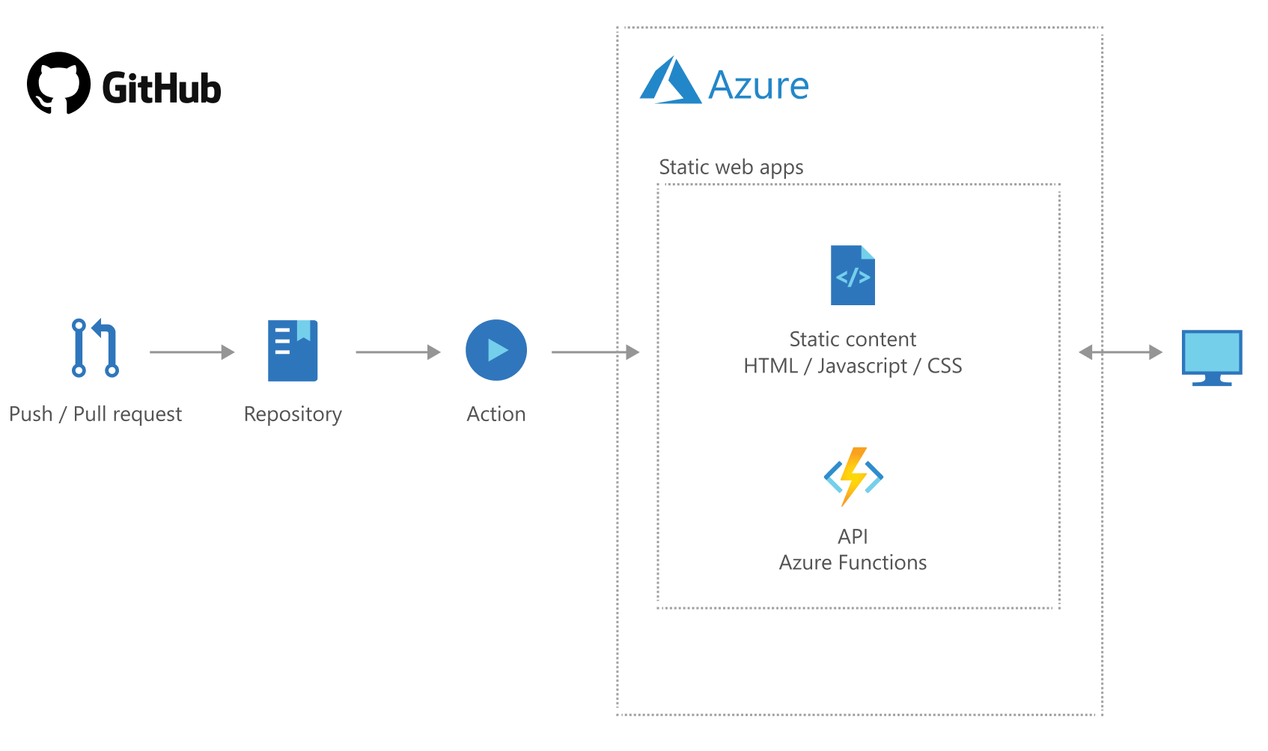
Static Web Apps
Released as Preview at Build 2020
Web hosting for static web content
Azure Function integration
GitHub integration for CI/CD
Supports custom domains
Auth provider integrations
Staging versions

Slide 4

Web Hosting for Static Content

Slide 5

Azure Function Integration

Slide 6

GitHub Integration for CI/CD
Clone base repository in GitHub
Workflow for CI/CD

Slide 7

Custom Domains
Support for Custom Domains
No support for APEX in Preview

Slide 8

Authentication Provider Integration
Azure Active Directory
GitHub
Facebook
Google
Twitter
All providers enabled by default!

Slide 9
Staging Versions
Staging versions deployed automatically
Triggered with PR against main branch

Slide 10
Demo

Slide 11
Preview Quotas
https://docs.microsoft.com/en-us/azure/static-web-apps/quotas

Slide 12


